Slide 1
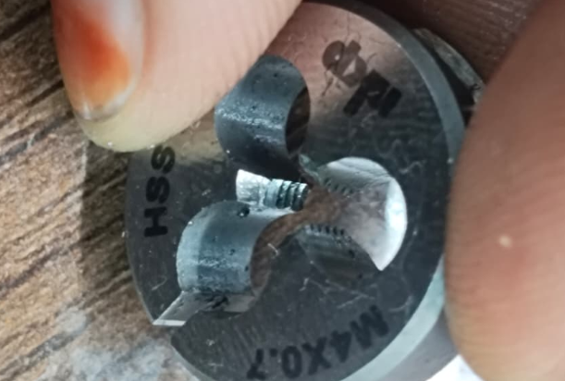
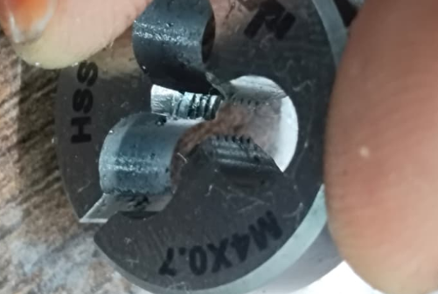
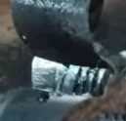
M.4*0.7 External Thread Die (OK )
M.4*0.7 External Thread Die (Not Ok )- Damaged
Part no : 100922920
Part name : Screw
Roots Causes.
M.4*0.7 External Thread Die worn-out
Without lubrication the die overheats and tears the metal.
Correction Action
That Replacement in Threat Die.
The Cut Oil Forcing in Direct Apply on Threat Die.

Slide 2
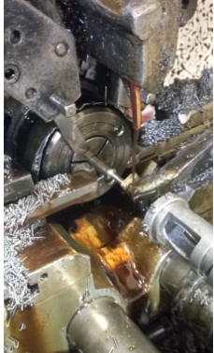
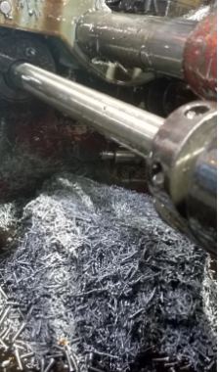
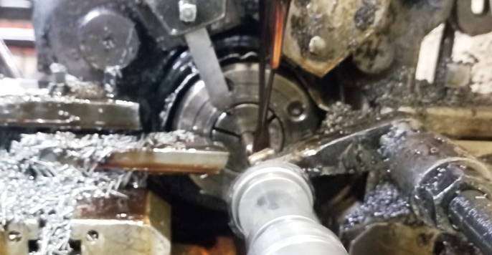
MACHINE NO: 07
BEFORE
AFTER

